Slide 1
Democracy- Chapter 1
Traces of democracy found in Greek, Mesopotamian, Indian civilizations.

Slide 2
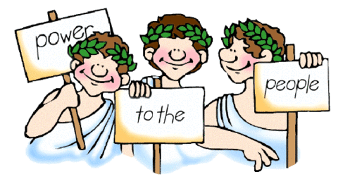
NOW LET’S FIRST UNDERSTAND WHAT DEMOCRACY IS !

Slide 3
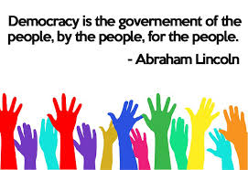
THE SIMPLEST WAY!

Slide 4
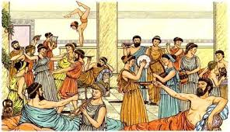
Direct form of democracy in Athens(Greece)
The citizens not only elected their politicians but also punished them by writing the name on a piece of ‘pottery’ called OSTRAKON.

Slide 5
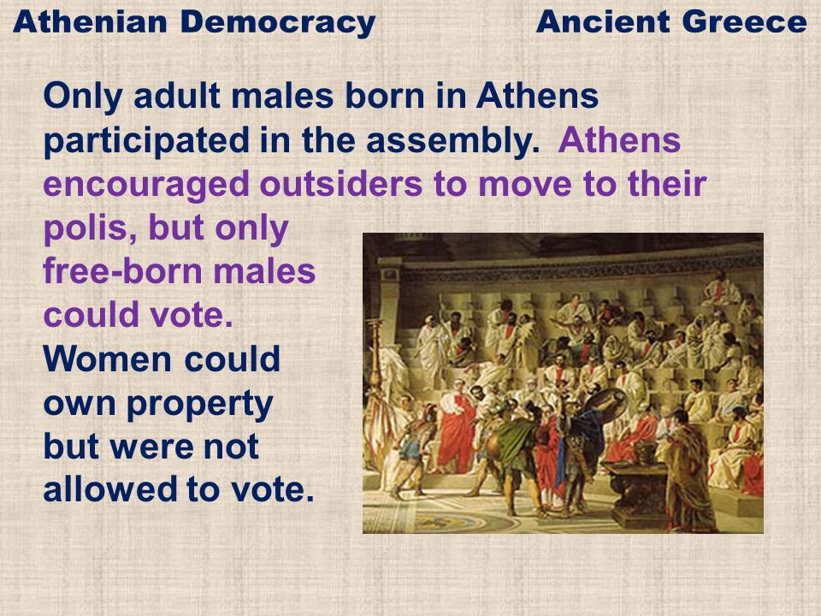
DEMOCRACY IN ATHENS
(UNDER PERICLES)
MAIN FEATURE- RIGHT TO VOTE
WHO COULD –ONLY LANDOWNERS, EDUCATED AND RICH
WHO COULD NOT- WOMEN, SLAVES,NON GREEK RESIDENTS

Slide 6
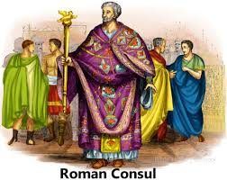
‘Elected ‘ consuls – form of democracy in Rome
The Roman assembly was called a Senate and elected members were called Consuls. Initially they were from amongst the Nobles, later , however the people won the right to elect their representatives as well as stand for Consulship.

Slide 7
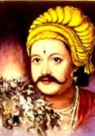
India-Elected ‘king’ – Gopala of the Pala dynasty
In 750 AD, a king was elected in Bengal. He started the Pala dynasty.

Slide 8
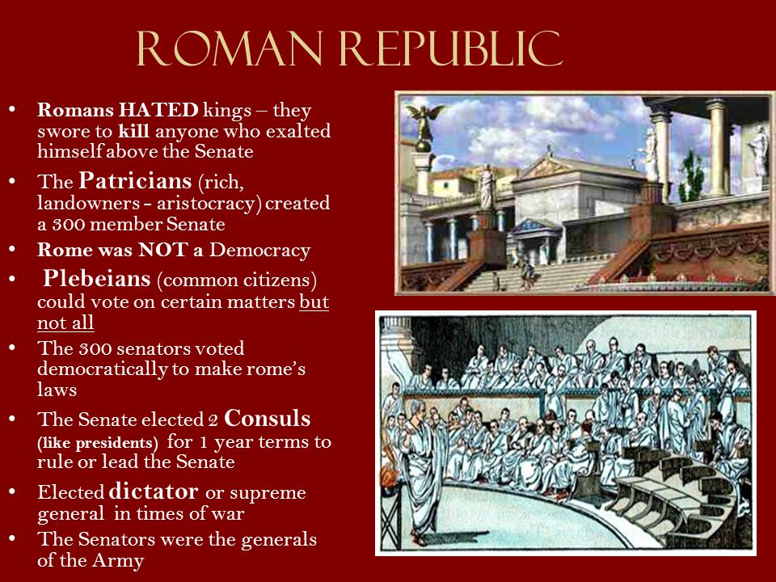
WHO VOTED DURING ROMAN RULE?
ONLY THE RICH AND THE MALES.
THEY HAD A REPUBLIC GOVERNMENT WHICH MEANSTHE REPRESENTATIVES OF THE PEOPLE WILL RULE – BUT THE RICH REPRESENTATIVES ONLY, NOT THE PLEBIANS OR POOR.

Slide 9
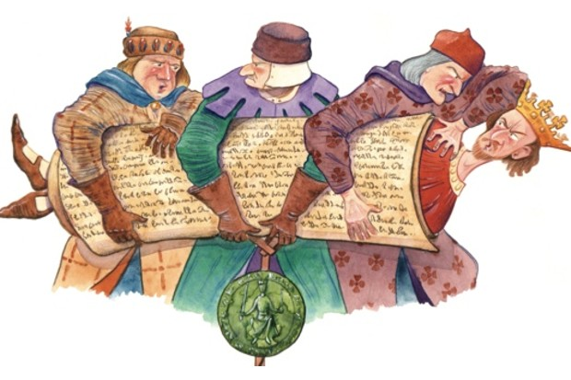
King John ruled England for almost two decades. (1199-1216) and was well known as a heavy handed ruler.

Slide 10
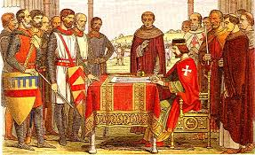
England- Magna Carta(1215)
The Magna Cart was created in England in 1215. This document represented the first time a written set of rules was dictated to a King of England by the subjects of the country, and led to the type of constitutional law we see today.

Slide 11
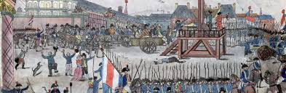
As the 18th century drew to a close, France's costly involvement in the American Revolution, and extravagant spending by King Louis XVI and his predecessor, had left the country on the brink of bankruptcy.

Slide 12
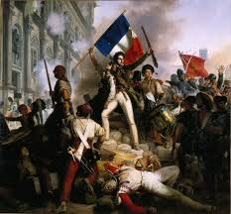
French Revolution-1799
Cause-the failure of King Louis XVI to properly manage his nation's finances and institute needed reforms. Wars, famine, and depression caused the population of Paris and France at large to unseat their leader and claim the country for themselves in the name of liberty.

Slide 13
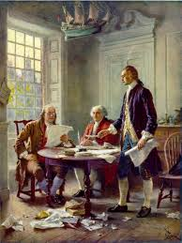
USA- Declaration of Independence(1788)
This document was highly significant because it announced the decision of the United States to become independent and free from British rule. More importantly, it explained

Slide 14
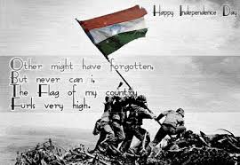
India- Independence from British Monarchs(1947)
India attained Independence on August 15th 1947, after a great political and social struggle. The British had ruled over India for a considerable period of time. Their initial intentions were to carry out trade in India, but in due course of time they developed political and administrative ambitions.

Slide 15
History of Democracy
Hope you all have understood the way various
Countries and their people fought to gain their rights……movement towards democracy. There were many more…..

Slide 16

Forms of government- oligarchy

Slide 17
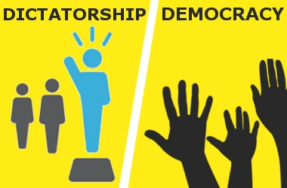
Dictatorship/ Democracy

Slide 18
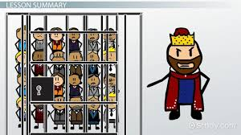
Monarchy

Slide 19

Best of Luck

